Slide 1

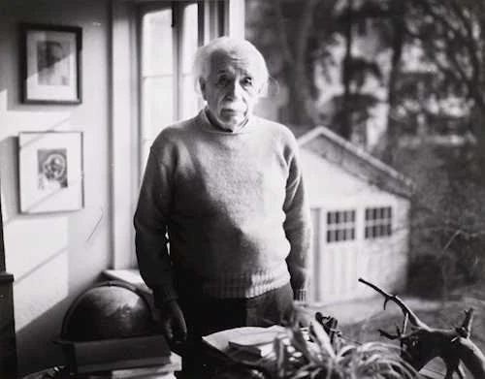

FBI
!Manhattan Project
WW1, WW2 OTTO-HAHN
WMD
FATHER OF DR JESUS CHRIST
AND SAINT PETER, APOSTLE 1
DR. DR. JOESEPH(Joachim) FISHAN
Max-Plank, Albert-Einstein-Institute
https://www.aei.mpg.de/
SAINT PETER, FEDERAL(US) REPULIC GERMANY
https://www.aei.mpg.de/
WW1
ALBERT-EINSTEIN
E=mc²
MAX-PLANK
F=MA
(delta)Government
(delat) WWII son
WW1
OTTO-HAHN
JFK.BULLET.SHOOTER(Kugelweg)
ATOMCLOCK(Quartz Circle)
2010
2016
Dropapple
Aftermath

Slide 2
FBI
!Manhattan Project
WW1, WW2 OTTO-HAHN
WMD
1988 Hudson(University of Davis, Physics Department)
2023 FORT WORTH(JFK), FORT MYERS(MLK)
nonPoliceDocumentsLogical
1989 HOUSES Gorvhcoeh(dr/j,jacko jacket fussball)
1990 PHYSICS(otto-Hahn-strasse)
1991 SCHOOL Gorbachev(dr/j,black or white)
2011-2016 Gorbachev(white:DUB-LOSGATOS)
ibm.damiler.sap.employe.dr.maik.lindner
Manhattan Project
1995
CAR(car-benz-strasse)
Gorbachev(dr/j lindner-hahn)
WWI; Otto-Hann, father of nuclear chemistry
2013 ATOMCLOCK(Quartz Circle)
Valley View
Trailer(sound cloud:80/443)
MATHEW:23
1990 Albert Einstein Institute
Max-Plank Institute
Berlin-East, CHECKPOINT_CHARLIE(brandenburger tor)
Grohceoh(Cisco, Mark:21)
Grohceo(visa, Mark:22)
Gocehoheo(cosco, Mark 24)

Slide 3
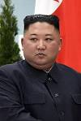





FBI
!Manhattan Project
WW1, WW2 OTTO-HAHN
WMD
Blinki-lights
Dr. Rice
Call you rice (Visa:Mopay)
X(SQ-MANNHEIM)
Gorbachev(Dr/j Hahn)
Ibm.damiler.sap
2) Call you rice (Visa:Tango:Mopay)
Dr. Rice
Petersson.nonPoliceCourtInteruptLogical
NAME_CHANGE_DOCUMENT
Ibm-dns: dropapple.com
Self-destruction
Tim cook, United States
1D8723 Apple
Da Bomb
After Math
[x] no
Gorbachev(Dr/j Hahn)
Ibm.damiler.sap

Slide 4

FBI
!Manhattan Project
WW1, WW2 OTTO-HAHN
WMD
PREA
§187
Blinki Lights
ibm.damiler.*
Cherrytree.Gorbachev(Depress, ibm.damiler.walmart.o.pbs.Sandra
$1 frontdoor sandles (wife)
(depress)
(sandra)
https://www.youtube.com/watch?v=w9QnckO9pJ8
2009 Stuttgart(1500 A.D.) ( Sweeper, IBM JVM Sweeper)
nonPoliceTimerLogical
Apple
Google
(touchurban: counter)
Yahoo
Walmart
Costco
Walmart.com
2014
2016
2010, 2019
2015
2008
Ibm.damiler.employe.frank.?
nonPoliceTimerLogical
Jobs/jobs/meiers/meiers/meiers/meiers/meiers/meiers
0.1 Assumed: SUPPLIER ATOMCCLOCK(Quartz Circle) EXTORTION
Chinese Factory Suppliers
PRICES, MERKEL(LARY WALL)

Slide 5
FBI
!Manhattan Project
WW1, WW2 OTTO-HAHN
WMD
PREA
§187
Blink-i-Lights
ibm.damiler.*
Cherrytree.Gorbachev(Depress, ibm.damiler.walmart.o.pbs.Sandra
$1 frontdoor sandles (wife)
(depress)
(sandra)
https://www.youtube.com/watch?v=w9QnckO9pJ8
2009 Stuttgart(1500 A.D.) ( Sweeper, IBM JVM Sweeper)
nonPoliceTimerLogical
Apple
Google
(touchurban: counter)
Yahoo
Walmart
Costco
Walmart.com
2014
2016
2010, 2019
2015
2008
Ibm.damiler.employe.frank.?
nonPoliceTimerLogical
Jobs/jobs/meiers/meiers/meiers/meiers/meiers/meiers
LinkedIn
2014
0.1 Assumed: SUPPLIER ATOMCCLOCK(Quartz Circle) EXTORTION
Chinese Factory Suppliers
PRICES, MERKEL(LARY WALL)
nonPoliceTimerLogical
2010 Gas Station(ss; timo boesser)
nonPoliceTimerLogical
iWatch
nonPoliceTimerLogical
nonPoliceTimceLogical
Norway Nation Handball Team, Airport

Slide 6
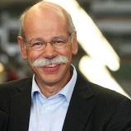
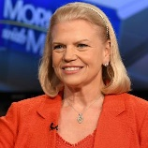
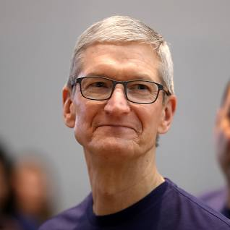
FBI
!Manhattan Project
WW1, WW2 OTTO-HAHN
WMD
PREA
§187
ibm.damiler.*
He is black
Yes, he is
Blink-i-Lights
Hello, Kim Jun Un you have
Green light to send Atom bomb
To California, it could even hit
Cupertino

Slide 7

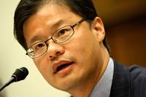

FBI
!Manhattan Project
WW1, WW2 OTTO-HAHN
WMD
PREA
§187
At IBM we belive in
Jerry Yang testing
Blink-i-lights on Disneyland
With Kim-Jun-Un
ibm.damiler.*
Blink-i-Lights
Hello, Kim Jun Un you have
Green light to send Atom bomb
To California, it should hit Tiberroun
Working with IBM
Has been a pleasure
And the Atomic Destution
Of the United States of America

Slide 8
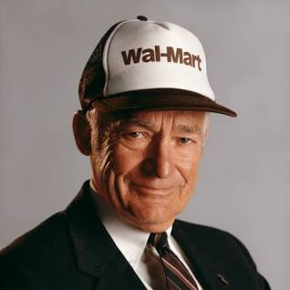

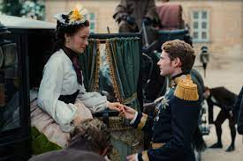
FBI
!Manhattan Project
WW1, WW2 OTTO-HAHN
WMD
PREA
§187
ibm.damiler.*
WWI. IPX SW.nonPoliceNSA.nonPoliceIncident
WWI.KING. (bismarkstrasse)
Sisi
Let me try

Slide 9
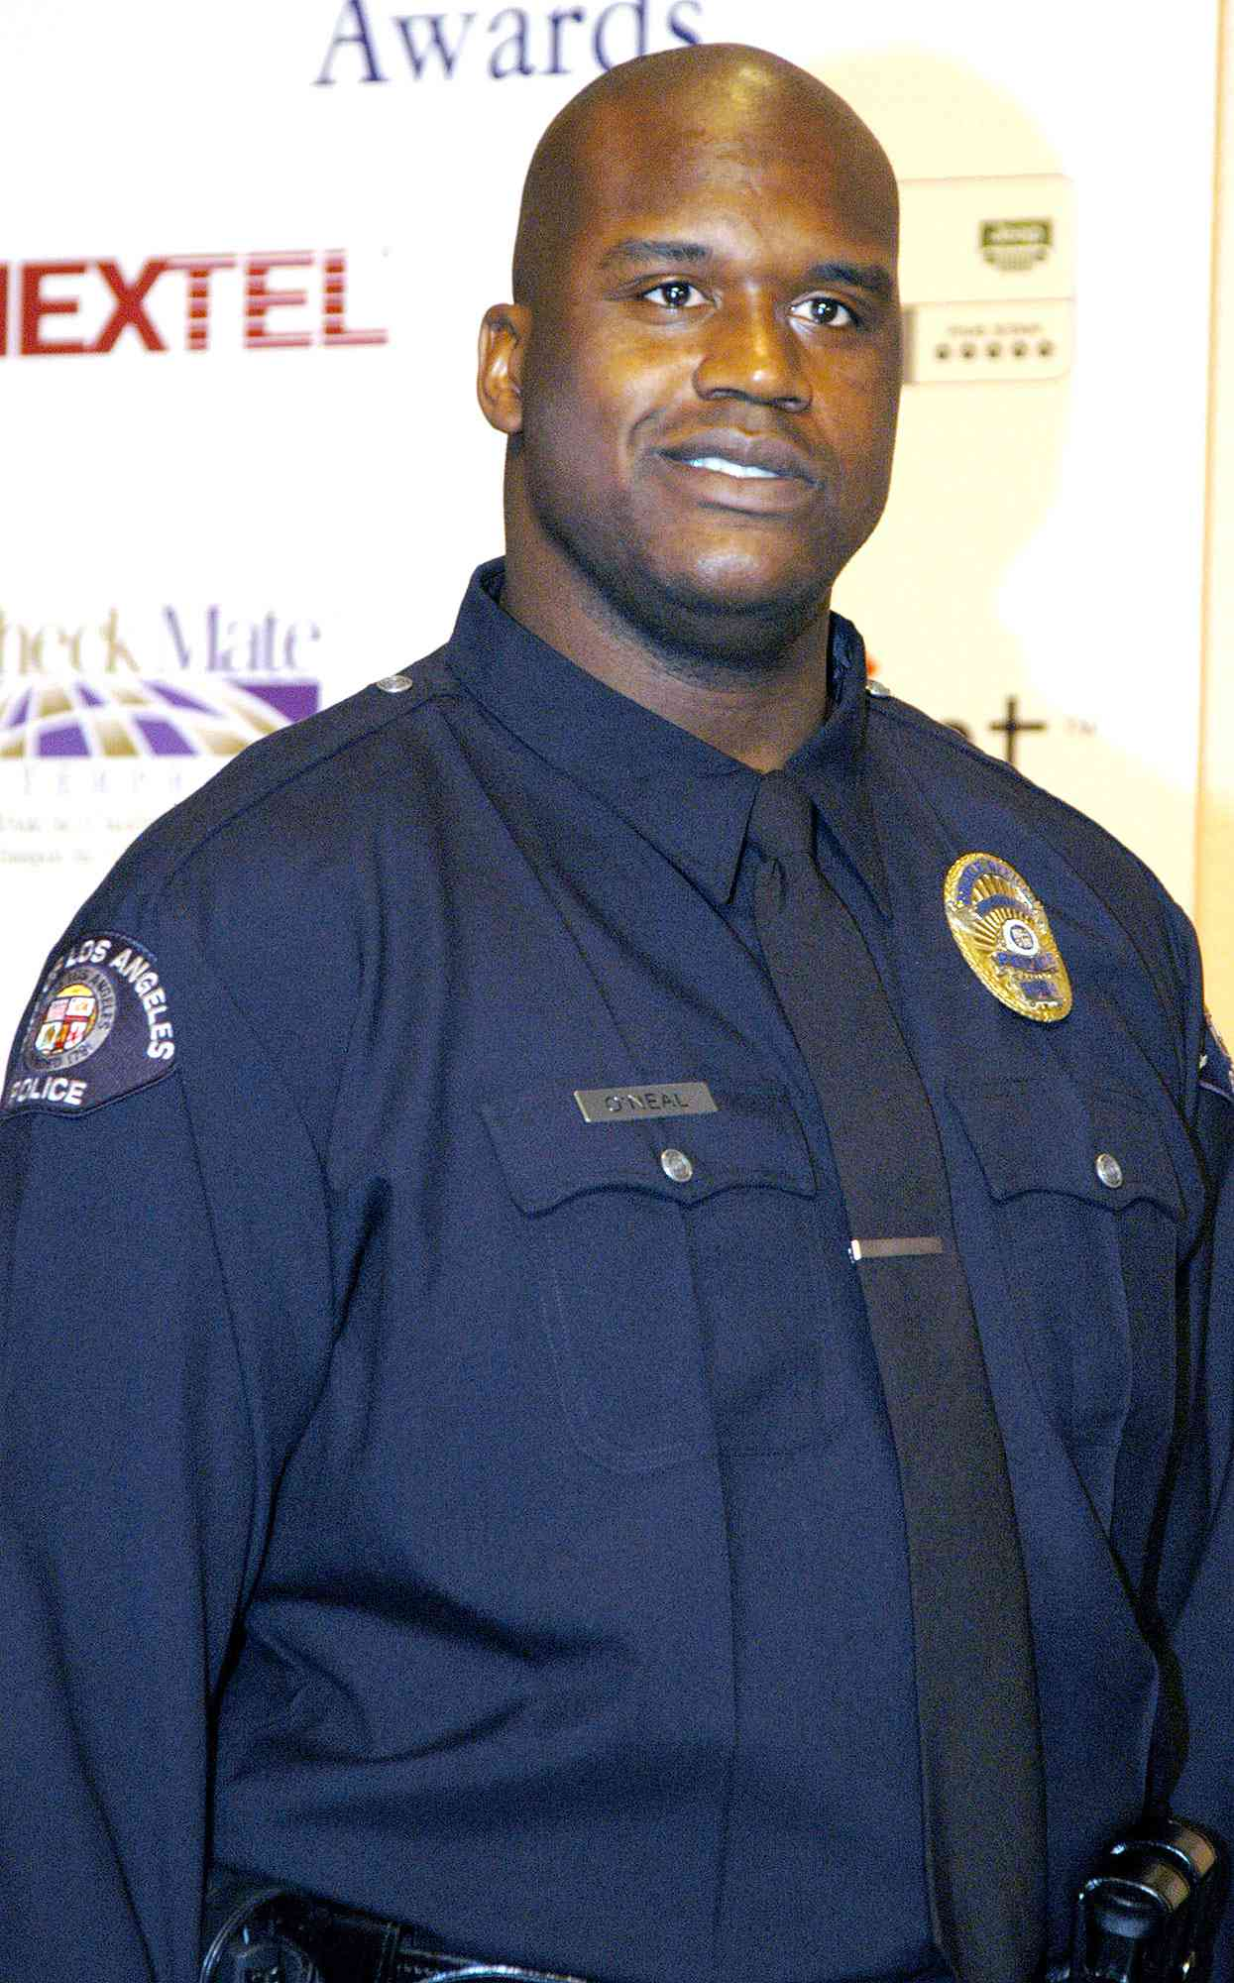
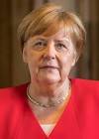
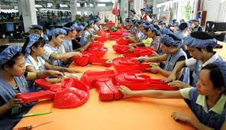
FBI
!Manhattan Project
WW1, WW2 OTTO-HAHN
WMD
PREA
§187
ibm.damiler.*
PRICE, Larry
Larry wall
Blink-i-Lights
Factory in China

Slide 10
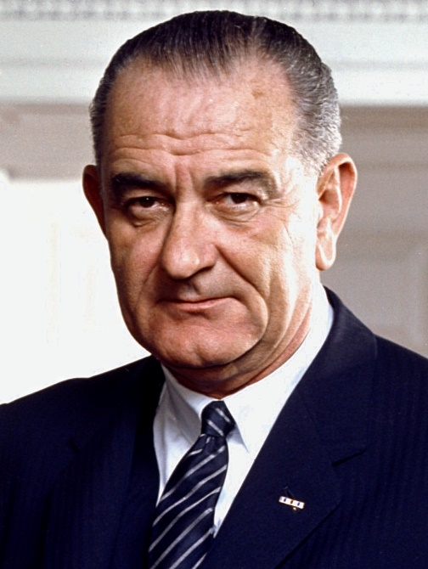
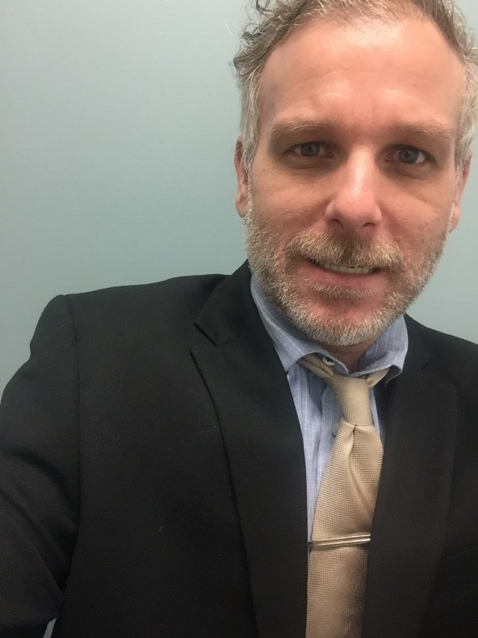
FBI
!Manhattan Project
WW1, WW2 OTTO-HAHN
WMD
FATHER OF DR JESUS CHRIST
AND SAINT PETER, APOSTLE 1
DR. DR. JOESEPH(Joachim) FISHAN
Max-Plank, Albert-Einstein-Institute
https://www.aei.mpg.de/
SAINT PETER, FEDERAL(US) REPULIC GERMANY
ATOMCLOCK(Quartz Circle)
2010
ATOMCLOCK(Quartz Circle)
2016
Dropapple
Aftermath
JFK.BULLET.SHOOTER(Kugelweg)
LABOR_CODE
CIVIL_CODE.CHERRTREE

